Slide 1
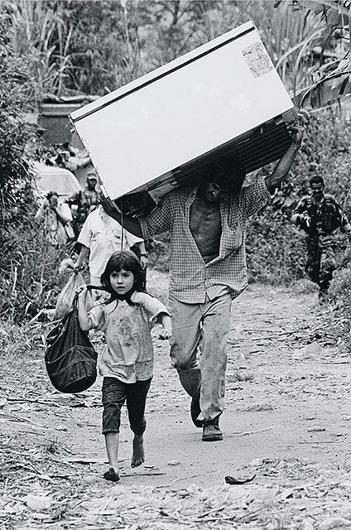
Ana María Ibáñez and Andrés Moya Universidad de los Andes
Violence, Civil Conflict, and Remittances
A Case Study of Monetary Transfers
for Forced and Economic Migrants in Colombia
Measuring Remittances Sent to and From Refugees and IDPs
KNOMAD Workshop
World Bank, February 12, 2016

Slide 2
Violence and Forced Displacement in Colombia
Colombia has been ravaged by a long-lasting civil conflict since 1948
Since 1985 increasing patterns of civilian victimization
220,000 Colombians have died – 85% of them civilians
7.3 million people have been victimized
6.1 million people have been displaced from their homelands – 13% of the Colombian population
Notes:
69

Slide 3
Violence and Forced Displacement in Colombia
Violence and displacement drive IDP into chronic poverty (Ibáñez and Moya, 2010 and 2010a; Moya, 2015; Moya and Carter, 2015)
95% of IDP are below the official poverty line
75% of IDP are below the extreme poverty line
Loss of 54 and 28 percent of income and consumption levels
Persistence of poverty is explained by a massive loss of physical, human, social, and psychological assets
Extensive research on the different dimensions of forced displacement
… except on those related with remittances
Notes:
69
From a humanitarian and development policy perspective it is essential, considering the vulnerability of IDP

Slide 4
Distinctive features of displacement and their relationship with remittances
Forced Migration: a responses to violence, rather than an economic decision
Very few return after being displaced
Profile of IDP reveals a higher vulnerability to poverty; no self-selection of “capable” migrants
Greater altruistic motivations to send remittances to those who stayed in conflict regions, but a lower capacity to actually make such transfers
Reception of remittances can help coping with the shock of violence and displacement
Notes:
1. 3 reasons: Preventive, Escape from hadrships and preserve life, reactive as a consequence of direct exposure
2. As violence intenifies, sociodemographic and economic profile changes, entire households migrate, women, children and elderly. Lower capacity to generate incomes
3. Greater motivations, but lower capacity; not only profile, but also disruption of networks, financial institutions, and risk of expropriation
4.

Slide 5
We provide a first approximation to remittances in the context of forced migration in Colombia
Which factors shape the decision to migrate in Colombia?
How does violence affect the likelihood of receiving and sending monetary transfers for migrants and non-migrants?
What data do we require to better understand remittances and monetary transfers in the context of widespread violence and displacement?
Notes:
69

Slide 6
Data: ELCA Encuesta Longitudinal Colombiana de la Universidad de los Andes
1st longitudinal household survey of its kind in Colombia
Baseline in 2010; 1st follow-up in 2013; 2nd follow-up 2016 (currently)
Urban Sample:
5,275 households in 48 municipalities
Representative at the national level for social strata 1-4 (out of 6)
Rural Sample
4,555 households in 77 municipalities and 244 rural communities
Representative for 4 rural micro regions
Notes:
69

Slide 7
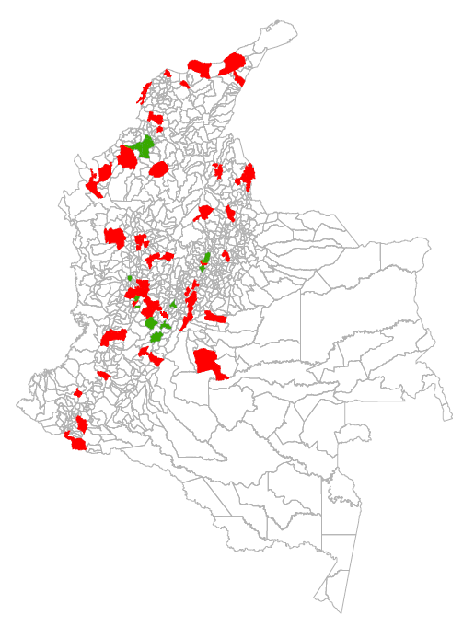
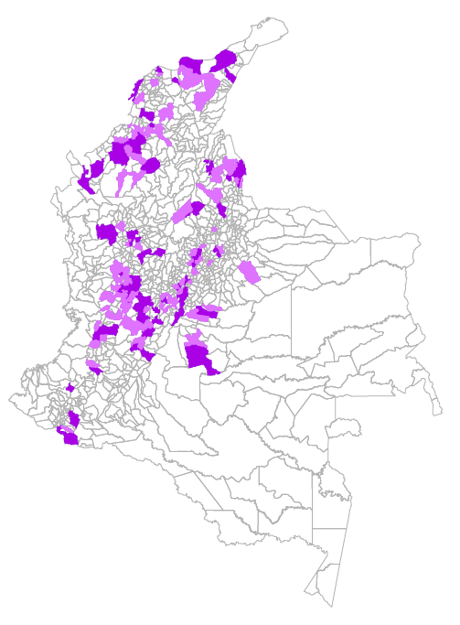
ELCA Longitudinal Survey - Migration patterns
The survey was not explicitly designed to identify and analyze displacement or migration dynamics
Sample in 2010: 80 municipalities
Sample in 2013: 171 municipalities
8% and 13% of the urban and rural samples migrated between the first two rounds, respectively
Notes:
69

Slide 8
ELCA Longitudinal Survey - Limitations
We do not observe why households migrated between 2010 and 2013
We cannot accurately distinguish forced migrants from traditional migrants
But! we have data on individual and community exposure to violence, including the presence of Non State Armed Actors (NSAA)
No data remittances strictly speaking, but rather on monetary transfers
Without information on who sends transfers to the household and who is receiving the transfers sent by the household
Notes:
69

Slide 9
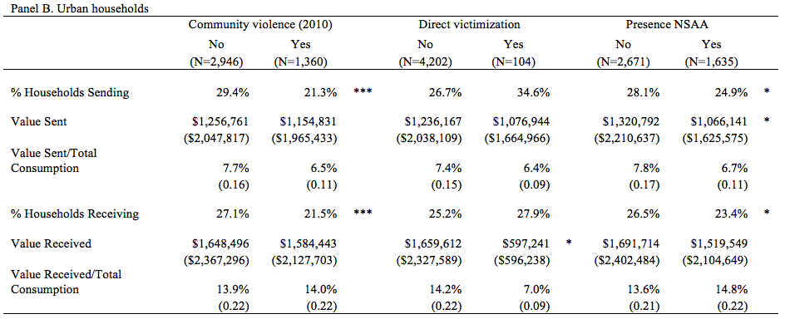
Descriptive Statistics: 2010 Violence and 2013 Monetary Transfers
Violence in 2010 is correlated with a lower likelihood of sending and receiving transfers in 2013
For rural and urban samples
For migrants and non-migrants

Slide 10
Results: Probability of Migrating
The decision to migrate is related to household sociodemographic characteristics and exposure to shocks
Wealthier, more educated, and younger households migrate with a higher likelihood – as in economic migration
As well as households exposed to different types of shocks – employment, asset, family ….
and violence shocks
Notes:
69
Violence measures are in general not statistically significant, due to low sample power, but point estimates of ideosyncratic shocks are of same magnitude of other shocks

Slide 11
Results: Transfers Sent and Received by Migrants
In general, violence is associated with a lower likelihood and amount of transfers sent by migrants
Although most point estimates are not statistically different from 0
Except when households split; migrants send more transfers and with a higher likelihood if the rest of the household stayed in areas controlled by NSAA – altruistic motive
The likelihood of receiving transfers and the amount of such transfers is lower if households migrated from regions controlled by NSAA
Especially if households migrated as a whole and permanently
Notes:
69
Violence measures are in general not statistically significant, due to low sample power, but point estimates of ideosyncratic shocks are of same magnitude of other shocks

Slide 12
Results: Transfers Sent and Received by Non-Migrants
Robust and significant effects of NSAA presence in 2010 on transfers sent and received by Non-Migrants
Violence lowers the likelihood of sending and receiving transfers, as well as the value of such transfers
Even when households split off
Notes:
69

Slide 13
What kind of data do we need to analyze remittances sent to and from refugees and IDPs?
Tradeoff between existing surveys and specific surveys focused on IDPs and remittances
Existing panel surveys allow observing dynamics, controlling for ex-ante characteristics
But samples lack power for IDP and miss important data (exposure to violence, triggers of migration, remittance dynamics)
Specific surveys for IDP and refugees can do a better job of illustrating remittance and migration dynamics
Who is receiving transfers sent by migrants, who is sending transfers to migrants
How stable are these transfers?
Through which channels?
Conflict dynamics and exposure to violence
But, collecting data in context of violence is a challenge, and quite difficult to follow them over time
Notes:
69

