Slide 1

Projection of net migration using a gravity model
Joel E. Cohen
cohen@rockefeller.edu
Laboratory of Populations
Rockefeller University
& Columbia University
New York, NY USA
World Bank & United Nations Population Division, 2014-04-29
5/4/2014
5/4/2014
1
1
Notes:
5/4/2014
1
International migration: simple models
5/4/2014
1

Slide 2
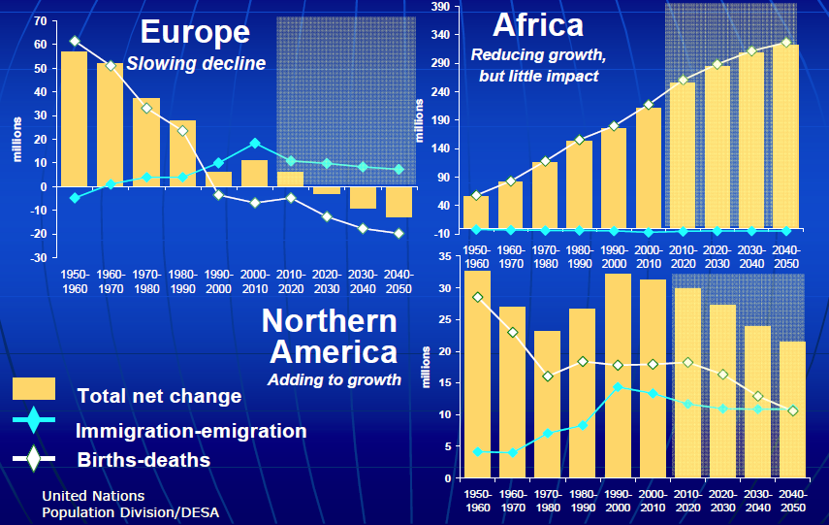
International migration affects population change differently in different regions.
Henning 2012
Notes:
Migration levels and trends: Global assessment and policy implications
New York, 10 February 2012
Sabine Henning
Migration Section, Population Division
Department of Economic and Social Affairs (DESA)
United Nations, New York

Slide 3
How to project
M(i,j,t)=number of migrants from i to j between t & t+1,
simultaneously
for all origins i & all destinations j?
Who is a migrant?
Definitions are difficult & various.
Tourist? Student? Transborder worker? Military abroad? Foreign only? Undocumented?
5/4/2014
3
Notes:
5/4/2014
3

Slide 4
Why use numbers of migrants?
UN projections of net migration did not automatically sum (over all countries) to 0.
In principle, migrant flows conserve number of people: if you leave one place, you arrive somewhere else.
Therefore, if you account accurately for migrant flows, net migration of all countries in world will automatically sum to 0 (ignoring deaths en route).
5/4/2014
5/4/2014
Joel E. Cohen
4
4
Notes:
5/4/2014
4
International migration: simple models
5/4/2014
4

Slide 5
Model should use variables that are not more difficult to project for decades than migration itself.
Some non-demographic variables are difficult to project for decades:
  Wage or other economic differentials
  Migration policies of origins & destinations
But areas, geographic distances, common borders, being landlocked, shared languages, prior colonial relationships, are relatively stable.
5/4/2014
5/4/2014
Joel E. Cohen
5
5
Notes:
5/4/2014
5
International migration: simple models
5/4/2014
5

Slide 6
Generalized gravity model
Define
M(i,j,t)=number of migrants from origin i to destination j between t & t+1.
P = population, D = distance
M(i,j,t) = c*P(i,t)ª *P(j,t)^{b} *D(i,j)^{d} ⬄
log M(i,j,t) = log c + a*log P(i,t) + b*log P(j,t)
+ d*log D(i,j).
This is a special case of a formula of Walter Isard, Methods of Regional Analysis 1961.
Notes:
Le Bras, Hervé 1990 Population et migrations. Ch. 34 in: Encyclopédie économique, Xavier Greffe, Jacques Maresse and Jean-Louis Reiffers, eds., pp. 1233-1267. Paris, Economica. See p. 1247.

Slide 7
Net migratory flows to
USA
more developed regions
Gravity model
UNPD
estimate
Linear
model
WPP2010
projection

Slide 8
UN estimates for 2 regions
L = less developed regions
M = more developed regions
N = net migration (in – out)
from L less developed regions
to M more developed regions
L(t), M(t), N(t) = estimated numbers of people for t = 1950, 1955, …, 2005 in UN Population Division, World Population Prospects 2010

Slide 9

Gravity model for 2 regions
Using exponents from Kim & Cohen, International Migration Review 2010,
define $in\left(t\right)=L{\left(t\right)}^{0.728}M{\left(t\right)}^{0.602}$, [L to M]
$out\left(t\right)=L{\left(t\right)}^{0.373}M{\left(t\right)}^{0.948}$, [M to L]
$\hat{N(t)}=a×in\left(t\right)+b×out(t)$. [net mig]
Choose $a, b$ to minimize
$$\sum_{t=1950}^{2005}{{\left(N\left(t\right)−\hat{N\left(t\right)}\right)}^{2}}.$$
Then a = 0.001856, b = -0.002483 .

Slide 10

Projecting future net migration
$$\hat{N(t)}={10}^{−3}×[1.856×L{\left(t\right)}^{0.728}M{\left(t\right)}^{0.602}$$
$$− 2.483×L{\left(t\right)}^{0.373}M{\left(t\right)}^{0.948}]$$
For t = 1950, …, 2005, this is a smoothing of UN Pop. Div. estimates of net migration.
For t = 2010, …, 2095, use UN Pop. Div. projections of L(t), M(t).
The slowing rate of increase in projected $\hat{N(t)}$ results from slowing increase in projected L(t), M(t).

Slide 11
Estimation & projection for USA
Adapt Rogers (1995) biregional model for
USA(t) = population size of USA at t,
W-USA(t) = population size of world excluding USA at t.
Same least-squares fitting gives
a = 0.0003434, b = -0.0008283.

Slide 12

Linear model
The linear model assumes that the number of migrants per time interval from origin to destination is proportional to the population size of the origin, independent of the population size of the destination.
Linear model is a special case of the gravity model: $\hat{N(t)}=a×L\left(t\right)+b×M(t)$.
For L, M, we find a = 0.006008, b = -0.01181.
For USA, W-USA, a=0.0004924, b=-0.005835.

Slide 13
Critique (1)
Procedure treats UN Pop. Div.’s projected M(t), L(t) as if they were independent of N(t). Instead, one should project one 5-year interval at a time, including migration.
Quantitative effect is at most a few percent.

Slide 14
Critique (2)
Exponents from Kim & Cohen were based on flows to individual more developed countries from individual less developed countries & vice versa. Some migrants to or from USA came from, or went to, other more developed countries.
It would be desirable to estimate country-specific flows based on data on migration flows or time series of migrant stocks.

Slide 15
77,658 observations, 1950-2007
Kim & Cohen, Internat. Migration Rev. 2010
Time-series data on legal migration flows reported by 17 national agencies
Destinations: Australia, Belgium, Canada, Croatia, Denmark, Finland, France, Germany, Hungary, Iceland, Italy, New Zealand, Norway, Spain, Sweden, United Kingdom, United States
Origins: above except Canada, France, Spain, United States

Slide 16
Which predictors matter most?
Variable | Inflow coefficient | Outflow coefficient
log pop of dest. | 0.601 | 0.372
log pop of origin | 0.728 | 0.936
log distance | -0.819 | -0.660
log area of dest. | 0.234

Slide 17
Questions answered
Should inflows to wealthy Western countries be modeled same way as outflows? No.
Is the assumption of uncorrelated residuals better than alternative error structures? Yes.
How much do other demographic features besides population size influence migration? Infant mortality rate matters more than potential-support ratio (15-64/65+); both matter.
How much do social & historical factors influence migration? Substantially, but much less than demographic & geographic factors.

Slide 18
Future work
Get additional data for other countries & years (UN Pop. Div. released more data).
Evaluate indicator (dummy) variables for traditional sending & receiving countries.
Embed migration model in projection model.
Distribute projected migrants by sex & age distributions of migrants.
Study asymptotic behavior of projection models with embedded migration model.
Harmonize migrant definition & measurement.
5/4/2014
5/4/2014
Joel E. Cohen
18
18
Notes:
5/4/2014
18
International migration: simple models
5/4/2014
18

Slide 19

Thank you! Questions?
5/4/2014
Joel E. Cohen
Notes:
5/4/2014
19
International migration: simple models
5/4/2014
19
Panama City, photo by JEC

